Slide 1
Kanban Policy Game
Workshop

Slide 2
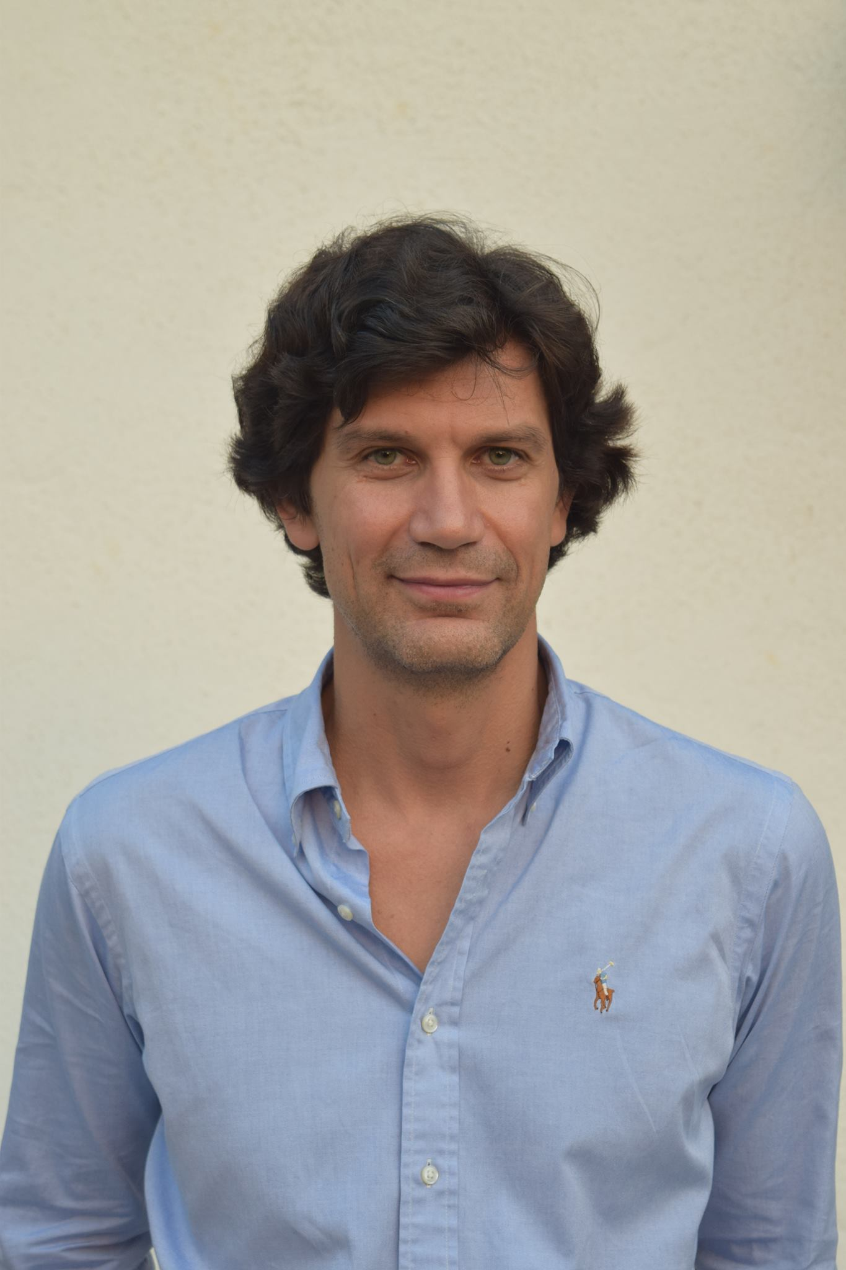
Dimitar Bakardzhiev is an expert in managing successful and cost-effective technology development. With his blend of technical, managerial and operational expertise, he effectively combines the theory and practice of Agile and Kanban Method to deliver business results.
As a Kanban trainer, coach, expert Kanban practitioner and Brickell Key Award 2015 Finalist, Dimitar puts lean principles to work every day when managing complex software projects. Dimitar has published David Anderson’s Kanban book as well as books on Lean, Theory of Constraints by Goldratt and Deming's Theory of Management in the Bulgarian language.
@dimiterbak

Slide 3
Agenda
Play the Kanban Policy Game
Run a software simulation of the game
Measure the collaboration level in a team

Slide 4
Kanban Policy Game

Slide 5
4
4

Slide 6
Heads (H) and Tails (T)

Slide 7
Setup (for each period)
Get into teams of 4 people.
Generate a backlog of 20 features using post-it notes of size 51x38 mm. Write the number of each feature in the center of a sticky note, leaving room top and bottom.
Choose just one card each, write your initials in the top left corner, and put it in the second column
Leave the remainder cards in the “Ready” column.
#1

Slide 8
Roles
Team member. Starts, moves, blocks/unblocks and completes work items.
Scribe. Writes down the coin tosses (H for Heads, T for Tails) for each team member for each day in the following table:
Day # | Team Name < >
 | Team member name < > #20 | Team member name < > #21 | Team member name < > #22 | Team member name < > #23
1 | H | H | T | H
2 | T | T | T | T
………………
10 | H | T | H | T

Slide 9
Rules
You as a team have 10 days to finish 20 cards. Each day begins with a “daily meeting”. In your “daily meeting” each of the team members should:
toss a coin,
share with the other team members the result,
then move the cards on the kanban board according to the rules and the policies.

Slide 10
If you throw Heads | If you throw Tails
Do one of: Advance one of your unblocked work items rightward by following what WIP Policy says OR Unblock one of your items that is blocked and advance it rightward by following what WIP Policy says OR Start new work by following what the Pull Policy says OR help others by following what the Collaboration Policy says | Do both: Block one of your currently unblocked items if you have one AND follow what the Pull Policy says

Slide 11
Blocking
When the rules require you to block a card, mark its sticky note with a “B”. If the rules require to block a blocked one don’t put another “B”.
When the rules require you to unblock a card, do that by crossing out the existing “B” on the sticky note. Example of one that has been blocked, unblocked and re-blocked: BB
DB
DB
#1
#1
B
BB

Slide 12
Illegal moves
A card cannot be moved more than once in the same day
When you pair to help a teammate both of you are allowed to move only one card. For example:
Team member #20 has T and team member #23 has H.
They pair and #23 moves the card that belongs to #20.
After that #20 has no T left i.e. no card should be blocked and a new card started.

Slide 13
If you have Heads (H) do only one of:
4
4
#4
DB
#3
Advance
#5
DB
#2
Unblock & Advance
|
B
#6
DB
2
XY
Help somebody else
Start a new card
#1
5
#7
XY shoould not block a card and start a new card!

Slide 14
If you have Tails (T) do both…
4
4
#4
DB
#3
#5
DB
#2
Block one card
B
#6
DB
2
Start a new card
#7

Slide 15
Metrics
When start a card put the day in the upper right corner
When finish the card put the day in the lower right corner
DB
2
#1
BB
5

Slide 16
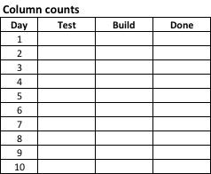
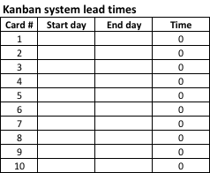
Log sheets

Slide 17
Imagine an agile transformation…
Playing the game

Slide 18
Period 1: Visualization and measurement
As your coach, I am hired by your leadership to help you improve your performance.
We will start by measuring how many features you’ll be able to deliver in the next 10 days.
Would your managers see the measurements?
Would your managers use the results for your performance appraisals?
Notes:
The facilitator plays the role of an Agile coach who as part of the company’s Agile transformation is engaged to work with the teams playing the game.
The coach says something to the tune of the following:
“I am hired by your leadership to improve your performance. You’ve been through a two days Kanban training and you do know what the method is.
We will start by measuring how many features you’ll be able to deliver in the next 10 days.
The end goal is for us to understand where are the areas that need improvement.
I know that you want to ask me – would your managers see the measurements?
My answer is – I guess so, because we will be transparent in order to improve.
If you ask me if your managers would use the results for your monthly performance appraisals – I don’t know. But you can safely assume it is highly likely they would.”
I have been looking around the place and talking to people in order to get myself familiar with the polices of your organization. Here are the policies I found to be in use in your organization:

Slide 19
Here are the policies in use in your organization
Collaboration Policy | Pull Policy | WIP Policy
We measure the individual productivity of the team members. Your goal is the Done column to have your name on as many work items as possible. Hence only if you have no other options, pair up with someone who threw tails and move on their behalf. Note: Follow the “WIP Policy” in regards the amount of work in process. | We want our resources to be fully utilized. Hence when their current work item is blocked team members should start working on a new work item by initial it and move to the Build column. Note: Follow the “WIP Policy” in regards the amount of work in process. | We can have unlimited number of work items in each of the columns.

Slide 20
If you throw Heads | If you throw Tails
Do one of: Advance one of your unblocked work items rightward by following what WIP Policy says OR Unblock one of your items that is blocked and advance it rightward by following what WIP Policy says OR Start new work by following what the Pull Policy says OR help others by following what the Collaboration Policy says | Do both: Block one of your currently unblocked items if you have one AND follow what the Pull Policy says

Slide 21
Reward the best
End of Period 1
Notes:
At the end of the period the facilitator will play the role of the management. The results of the game will be used for the performance appraisals.
The players who had the most cards under their names will be presented with a bonus in the form of a candy.

Slide 22
Debrief
In your teams, list and prepare to report back:
Concepts, practices, and outcomes simulated in the game
Your observations
Workplace parallels

Slide 23
Confirm the application of Kanban Method’s three core practices
CP1: Visualize
Work items
Work flow
Work item state – where in the work flow, whether blocked
CP4: Make policies explicit
CP5: Implement feedback loops
Daily standup meeting

Slide 24
Period 2: WIP limits
It is about time we start limiting our work in process.
It will make you more productive and work will be delivered faster.
We establish WIP limits by changing the WIP Policy. All other policies are the same.

Slide 25
Here are the policies in use in your organization
Collaboration Policy | Pull Policy | WIP Policy
We measure the individual productivity of the team members. Your goal is the Done column to have your name on as many work items as possible. Hence only if you have no other options, pair up with someone who threw tails and move on their behalf. Note: Follow the “WIP Policy” in regards the amount of work in process. | We want our resources to be fully utilized. Hence when their current work item is blocked team members should start working on a new work item by initial it and move to the Build column. Note: Follow the “WIP Policy” in regards the amount of work in process. | We are limiting our work in process to 1 item per team member for each of the columns. As a result only if a column has free capacity you can advance one of your cards rightwards.

Slide 26
If you throw Heads | If you throw Tails
Do one of: Advance one of your unblocked work items rightward by following what WIP Policy says OR Unblock one of your items that is blocked and advance it rightward by following what WIP Policy says OR Start new work by following what the Pull Policy says OR help others by following what the Collaboration Policy says | Do both: Block one of your currently unblocked items if you have one AND follow what the Pull Policy says

Slide 27
Reward the best
End of Period 2
Notes:
At the end of the period the facilitator will play the role of the management. The results of the game will be used for the performance appraisals.
The players who had the most cards under their names will be presented with a bonus in the form of a candy.

Slide 28
Debrief
In your teams, list and prepare to report back:
What changed?
Benefits?
Drawbacks?
Is the most productive team member the same as in Period 1?
Workplace parallels

Slide 29
Confirm the application of Kanban Method’s two core practices
CP2: Limit work-in-process (WIP)
Column limits, one way to balance workload vs capacity
We made a true kanban system (pull and limiting WIP)
CP3: Manage flow
Flow (smoothness, timeliness, economic outcomes)

Slide 30
Period 3: Collaboration allowed
The results from the last period were not as good as we expected.
I coached your leadership and managed to pursue them to change the performance evaluation policy that is to be used in the appraisals.
From now on the performance of each team will be taken as a whole and the bonuses will be allocated to the teams and shared by all team members.

Slide 31
Here are the policies in use in your organization
Collaboration Policy | Pull Policy | WIP Policy
We don’t measure individual productivity but the productivity of the team as a whole. Your goal is the Done column to have as many work items as possible no matter the name on them. Hence, If you want to help the team, pair up with someone who threw tails and move on their behalf . Note: Follow the “WIP Policy” in regards the amount of work in process. | We want our resources to be fully utilized. Hence when their current work item is blocked team members should start working on a new work item by initial it and move to the Build column. Note: Follow the “WIP Policy” in regards the amount of work in process. | We are limiting our work in process to 1 item per team member for each of the columns. As a result only if a column has free capacity you can advance one of your cards rightwards.
Notes:
We removed “and you have no other options” part from the Collaboration Policy. Everything else is the same.

Slide 32
If you throw Heads | If you throw Tails
Do one of: Advance one of your unblocked work items rightward by following what WIP Policy says OR Unblock one of your items that is blocked and advance it rightward by following what WIP Policy says OR Start new work by following what the Pull Policy says OR help others by following what the Collaboration Policy says | Do both: Block one of your currently unblocked items if you have one AND follow what the Pull Policy says

Slide 33
Reward the Team!
End of Period 3
Notes:
At the end of the period the facilitator will play the role of the management. The results of the game will be used for the performance appraisals.

Slide 34
Debrief
In your teams, list and prepare to report back:
What changed?
Benefits?
Drawbacks?
Workplace parallels

Slide 35
Confirm the application of Kanban Method’s last core practice
CP6: Improve collaboratively, evolve experimentally (using models and the scientific method)
We created conditions for collaboration in delivery
Nothing collaborative, experimental or scientific about our change

Slide 36
Final debrief
Notes:
After Period 3 is finished hold a final debrief. Ask all teams playing the game to share their results and reflect on them through the lens of the J-curve model of change.

Slide 37
Share the results by populating the Excel table
Team name | Period | Started work items | Finished work items | Remarks
1 | 1 | 19 | 5
 | 2 | 11 | 7
 | 3 | 13 | 9
… | …...
N | 1
 | 2
 | 3

Slide 40
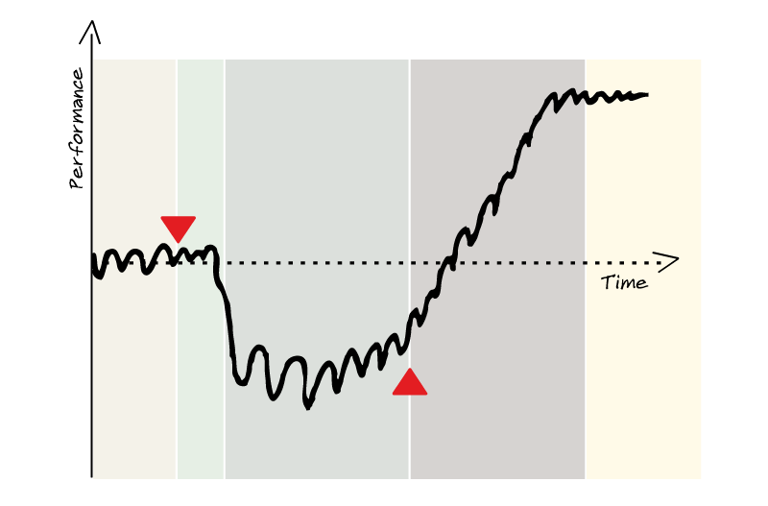
The J-Curve Effect
Safety!
Patience!
Virginia Satir’s J- Curve Model of Change
Notes:
A capability might be lead time, or quality, or due date performance or performance against an SLA.
The current capability or fitness level is shown as the horizontal oscillating curve on the diagram. This level of capability is delivered by the current process. The model assumes that the current level of capability is not sufficient and isn’t fit for purpose, so we are motivated to improve. Once we start the change initiative the current level of capability falls. We can measure the depth of the drop as the negative delta in capability. The depth and length of the drop incurred by the change can be thought of as the pain of change. If things go well then we gradually recover back to our previous level of capability and eventually we achieve a new improved level of capability.
It is the drop in capability and the eventual improvement that gives the concept its name – “the J-curve effect.”

Slide 41
Notes:
Show the results from all the games

Slide 42
Discussion
Simulation results

Slide 43
“System is not a sum of the behavior of its parts, it’s the product of their interactions.”
Russell L. Ackoff (1994)
https://www.youtube.com/watch?v=OqEeIG8aPPk
An event hosted by Clare Crawford-Mason and Lloyd Dobyns
to capture the Learning and Legacy of Dr. W. Edwards Deming.
Notes:
https://www.youtube.com/watch?v=OqEeIG8aPPk

Slide 44
“The goal is to make full use of the workers’ capabilities by building up a system that will allow the workers to display their full capabilities by themselves.”
Y. SUGIMORI, K. KUSUNOKI, F. CHO & S. UCHIKAWA (1977)
Toyota production system and Kanban system

Slide 45
“…use kanban to create a positive tension in the workplace by reducing work-in-process and that motivates people to do better than they ever thought they could do. Isn’t that what we are really aiming for?”
The Birth of Lean by Takahiro Fujimoto,‎ Koichi Shimokawa,‎ Jim Womack
Notes:
The goal is to make full use of the workers’ capabilities by building up a system that will allow the workers to display their full capabilities by themselves.
Build a system that will allow the workers to display their full capabilities by themselves (Y. SUGIMORI, 1977).
Reducing work-in-progress is not the objective – that’s only a tool. The objective is to expose problems.
If problems stop showing up – reduce your work-in-progress! We reduce work-in-process to make everyone feel the tension.

Slide 46
“The invisible purpose of kanban is to foster a creative tension in the workplace by reducing the work-in-process.”
The Birth of Lean by Takahiro Fujimoto,‎ Koichi Shimokawa,‎ Jim Womack

Slide 47
“…when he saw everyone rushing to help him, he realized the power of a system that gave each worker the right to stop the line if
something went wrong. The team leaders frequently step in to help or coach line workers and can cover any of the jobs in their team if needed. “
"THE TOYOTA WAY to LEAN LEADERSHIP” by Gary L. Convis and Jeffrey Like

Slide 48
“TPS is not just a production system, but a total management system that develops human ability to its fullest capacity to best enhance creativity and fruitfulness, utilizes facilities and machines well and eliminates all waste. “
Taiichi Ohno – “Toyota Production System”

Slide 49
“Using the analogy of a sports team jidoka corresponds to the skills and talent of the individual players while just-in-time is the teamwork involved in reaching an agreed upon objective. To accomplish this standard work procedures corresponding to each player’s ability must be adhered to at any time. When abnormities arise not covered in the standard work then special instructions from the coach must be given to bring the player back to normal. A championship team combines good teamwork with individual skill. Teamwork is essential. Harmony among the people in the team is in a greater demand than the art of the individual craftsman.”
Ohno Taiichi – “Toyota Production System”

Slide 50
“The aim of kanban is to make troubles come to the surface and link them to kaizen activity. “
Taiichi Ohno – “Workplace Management”
Notes:
The operating method of TPS is kanban "Ohno, Taiichi Toyota Production System".

Slide 51
“This system also encourages workers to pressure one another to maintain a rapid work pace. The teammates must work harder if one of them is too slow or mistake prone since this will disrupt the flow of work through the team’s station. This will make it difficult for the team to complete its collective job assignment on time. Because of kanban synchronized production schedule a team’s problem will have a negative ripple effect on the next team down the line. The end result of this kanban synchronized system is a plant where everyone minds everyone else’s business. The rationale is simple – if we must bear the consequences of your actions, we have the right to demand your actions conform to our standards "
Fucini, Joseph J.; Fucini, Suzy Working for the Japanese: Inside Mazda's American Auto Plant
Notes:
Collaboration:When in trouble the worker knows exactly what to do which is to get the adnon rope and call for help. They have someone to help the worker right there on the spot. As they help the worker make things better they are developing the worker. That is a learning organization on a micro level of getting the work done. Everyone has a permission to fail and the ability to succeed.

Slide 52
Conclusion
If there is no collaboration and we limit WIP then the performance goes south
At the same time
Only if WIP is limited the team has to collaborate in order to reach their best performance.

Slide 53
List your conclusions
Work

Slide 54
Measure Collaboration Level

Slide 55
4
4

Slide 56
Setup
Get into teams of 4 people.
Generate a backlog of 20 cards using post-it notes of size 51x38 mm. Write the number of each card in the center of a sticky note, leaving room top and bottom.
Choose just one card each, write your initials in the top left corner, and put it in the second column
Leave the remainder cards in the “Ready” column.
Get ready with the “Updates from environment” cards
DB
#1

Slide 57
Roles
Team member. Starts, moves, blocks/unblocks and completes work items.
Scribe. Logs the number of cards delivered each day and their lead times.

Slide 58
Updates from environment
Day # | Daily Update Card
 | Team member #20 | Team member #21 | Team member #22 | Team member #23
1 | H | T | T | T

Slide 59
Rules
You as a team have 10 days to finish 20 cards. Each day begins with a “daily meeting”. In your “daily meeting”:
the team opens a Daily Update Card,
each of the team members read their update from environment, share with the other team members the result,
then move the cards on the kanban board according to the rules and the policies.

Slide 60
If you have Heads (H) | If you have Tails (T)
Do one of: Advance one of your unblocked cards rightward by following what WIP Policy says OR Unblock one of your cards that is blocked and advance it rightward by following what WIP Policy says OR Start new card by following what the Pull Policy says OR help others by following what the Collaboration Policy says | Do both: Block one of your currently unblocked cards if you have one AND follow what the Pull Policy says

Slide 61
Policies to be followed
Collaboration Policy | Pull Policy | WIP Policy
We don’t measure individual productivity but the productivity of the team as a whole. Your goal is the Done column to have as many cards as possible no matter the name on them. Hence, If you want to help the team, pair up with someone who threw Tails and move on their behalf . Note: Follow the “WIP Policy” in regards the amount of work in process. | We want our resources to be fully utilized. Hence when their current card is blocked team members should start working on a new card by initial it and move to the Build column. Note: Follow the “WIP Policy” in regards the amount of work in process. | We are limiting our work-in-progress to maximum of 4 cards in each of the Build and Test columns. As a result only if a column has free capacity you can advance one of your cards rightwards.

Slide 62
Blocking
When the rules require you to block a card, mark its sticky note with a “B”. If the rules require to block a blocked one don’t put another “B”.
When the rules require you to unblock a card, do that by crossing out the existing “B” on the sticky note. Example of one that has been blocked, unblocked and re-blocked: BB
DB
DB
#1
#1
B
BB

Slide 63
Illegal moves
A card cannot be moved more than once in the same day i.e. the same card to move from Build to Test then Done.
When you pair to help a teammate both of you are allowed to move only one card. For example:
Team member #20 has T and team member #23 has H.
They pair and #23 move the card that belongs to #20.
After that #20 has no H left i.e. no card should be blocked and a new card started.

Slide 64
Metrics
When start a card put the day in the upper right corner
When finish the card put the day in the lower right corner
DB
2
#1
BB
5

Slide 65
Log sheets

Slide 66
Cumulative Flow Diagram (CFD)

Slide 67
Kanban system lead time run Chart

Slide 68
Before we begin…
One team to have two of their members pretend to be deaf…
One team to have two of their members dumb…
One team to have all their members deaf and dumb
Last team is OK!

Slide 69
Discussion
Game results

Slide 70
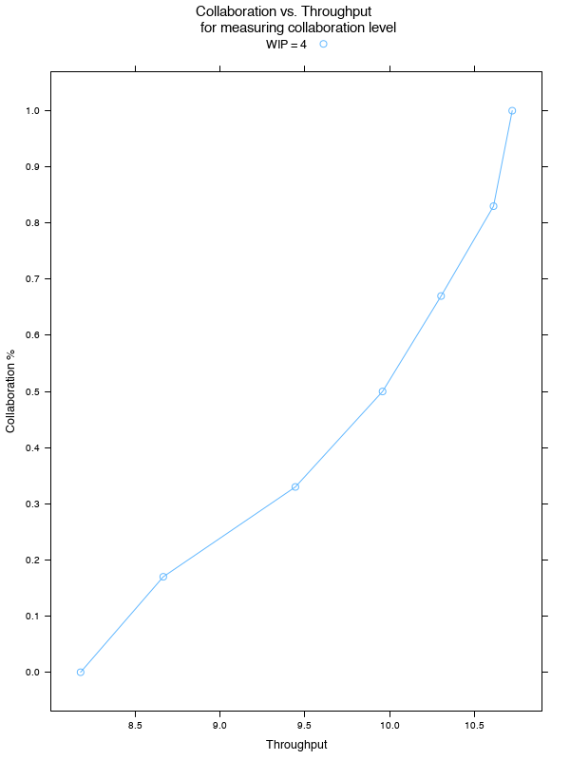
Find your throughput on the X-axis
Draw an imaginary vertical line from the point you marked on the X-axis until it hits the blue curve
Find the corresponding point on the Y-axis – that’s your team’s collaboration level

Slide 71
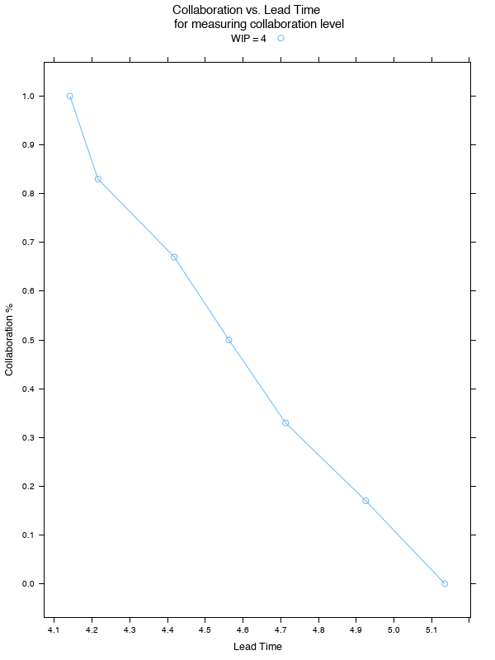
Find your Lead Time on the X-axis
Draw an imaginary vertical line from the point you marked on the X-axis until it hits the blue curve
Find the corresponding point on the Y-axis – that’s your team’s collaboration level

